Slide 1
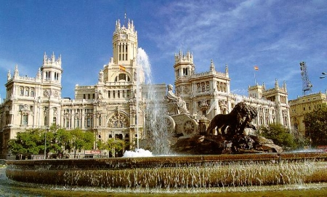
Madrid

Slide 2
Spain: TWELTFH NIGHT
The role of women is cooking.
The role of man is sitting in the armchair
It’s similar in Germany, Italy and Turkey but in Poland man help more then in the other countries.

Slide 3
Germany: THE SECRET OF THE CHRIST CHILD
In Germany Christmas, all have to stick together in the preparation, the man have to get the Christmas tree and the woman have to put the house in order and cook and bake. The young boys to help dad with the tree and electric and the girls help their mothers to bake and bring the house in order.

Slide 4
Turkey: THE FIRST STEP TO GET MARRIED
The role of the man and the women in the performance is the same.
The parents of the bridegroom and the parents of the groom speak together about the future of their children.

Slide 5
Italy: CHRISTMAS IS SERVED!
In Italy the woman prepare the food while the men are sitting on the sofa and cook the lamb.
It’s similar in Germany, Italy and Turkey but in Poland man help more then in the other countries.

Slide 6
Poland: WIGILIA BOZEGO NARODZENIA
In Poland women cook and tidy the house. Men help the wife, they kill the carp and buy the christmas tree. Children help their parents.
Before having dinner, Polish use to read the Bible and eat the holly wafer. Polish people sing the traditional Christmas songs, at midnight polish go to the church to the Midnight Mass.

